Slide 1
Allstate
Insurance Purchase Prediction
Xin Yu, Lan Yan, Siqi Ren
Notes:
Good afternoon, everyone. This is our team member, siqi, lan and I’m xin. We are very glad to introduce our project here.

Slide 2

Agenda
Project Introduction
Modeling Process
Testing results
Demo & Conclusion
Notes:
Today, we gonna talk about our project in 4 parts, project introduction, modeling process, testing results, demo and conclusion.

Slide 3

Project Introduction
Goal:
Predict the purchased coverage options using the data given about interaction history.
Data:
665,250 Original, 26 variables
7 coverage options
532,200 Training
133,050 Testing
Clean, transfer
Preparation
Apply model
Modeling
Testing
Decision Tree
Notes:
First introduction. Our dataset is about allstate insurance purchase prediction. We extracted over 660,000 records from kaggle, including 26 variables. After data exploration and preparation, we divide all the data into two parts. 80% of it is for training data, which is used for modeling and predication, other 20% is testing data, which is used for calculate models performance. Within this project, we want to find the relationship between purchased coverage options and other attributes and also want to predict people’s future purchase behavior.

Slide 4
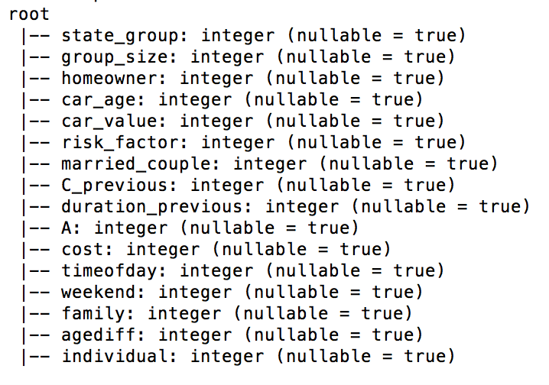
Data Preparation
Group and Dummy
Missing Value
New variables:
timeofday
weekend
family
individual
agediff
Group:
state_group
Dummied:
homeowner
car_value
risk_factor
married couple
c_previous
Replaced risk_factor using linear regression
Replaced c_previous with 0
Replaced duration_previous with 0
Notes:
For data preparation, first we noticed that there are 3 variables contain missing values, which are risk_factor, c_previous, and duration_previous.
risk_factor stands for the assessment of the customer, c_previous is what the customer previously have for option C, and duration_previous means how long the customer has been covered with allstate.
All of them seemed pretty important in predicting the result, so we used linear regression to fill in the missing values for risk_factor. Then we considered that the NA in the two previous variables might stand for new customers since they don’t have history records, so we substitute the missing values with 0.
Then we created some new variables such as timeofday, weekend, family, individual, and agediff, they are related to when the customer gets the quote and customer family’s condition. We also grouped states based on regions into 5 categories. Finally we dummied the variables. And we now have 15 independent and 7 dependent variables.

Slide 5
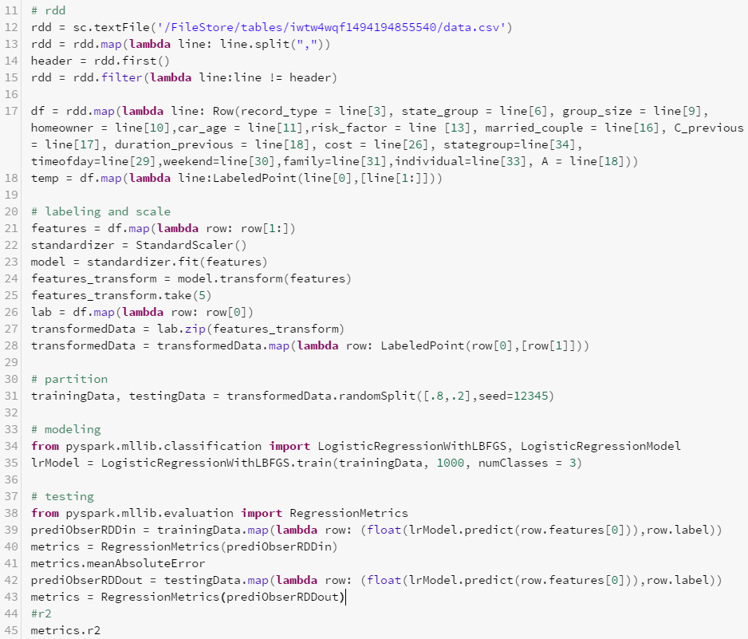
Modeling
Option A:
r^2: 0.13
Multinomial Logistic
Rules are based on patterns of data
High volume of combination ( 2,304)
Association Rule
Notes:
Since the original dataset have 7 coverage options, which means that there are 2,304 possible combinations. We chose not to predict the coverage combination since we find that most combinations won’t be used in reality. Also, predicting the combination will not only takes vast amount of machine process, but also result in very low accuracy. Instead, we believe that it is better to predict the 7 individual options for each customer and combine them, rather than predict the entire combination using a single model.
In choosing the algorithm, first we tried modeling option A with multinomial logistic regression, As the code on the right shows.
We load the dataset and put it in RDD, then labeling it and scale the variables. And we partitioned data, giving 80% training and 20% testing. Then we modeling it using LogisticRegressionWithLBFGS package. Then we evaluated the model, it cames with R^2 of 0.13, which is very low.
Then we analyzed the association rules, we found that the result won’t be better. Because the rules are based on patterns in the data, however, due to the high volume of combinations, the patterns won’t always be correct.

Slide 6
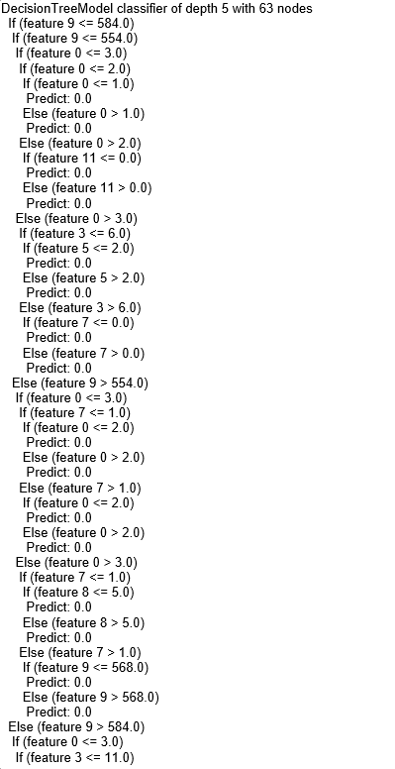
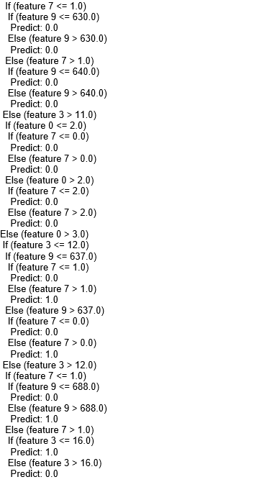
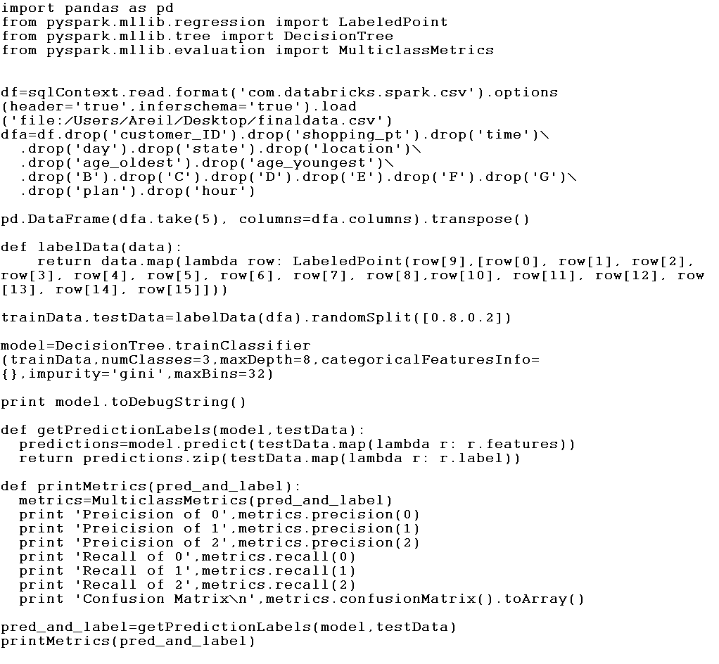
Modeling
Option A:
Precision of 0: 0.72
Precision of 1: 0.73
Precision of 2: 0.35
Decision Tree
Notes:
Lastly, we tried modeling option A with decision tree and it cames with precision of 0.7 for 2 of the values and 0.35 for the left value (total of 3 values possible). Therefore we decided to modeling with Decision Tree.
The code on the right is how we modeled with option A. After loading dataset, we dropped some variables such as customer ID. Then we labeled the data and partitioned, then we build a model and evaluate it based on precisions.
Then here is the result of decision tree for one of the insurance option.

Slide 7
Results
C
A
E
F
B
D
G
Precision of 0: 0.72
Precision of 1: 0.73
Precision of 2: 0.35
Precision of 0: 0.59 Precision of 1: 0.55
Precision of 0: 0.73
Precision of 1: 0.64
Precision of 2: 0.71
Precision of 3: 0.59
Precision of 1: 0.43
Precision of 2: 0.48
Precision of 3: 0.68
Precision of 0: 0.67
Precision of 1: 0.62
Precision of 0: 0.68
Precision of 1: 0.46
Precision of 2: 0.55
Precision of 3: 1.0
Precision of 0: 0.49
Precision of 1: 0.49
Precision of 2: 0.53
Precision of 3: 0.44
Notes:
By iterating maxDepth and numClasses, we got models for each of the insurance option, and as you can see the precisions are pretty good. The lowest precision for a single value in a option is 0.35, and highest is 1.0. Now Lan will give us a demo on the prediction system.

Slide 8
System Demo:
http://allstate.efj26cyzfh.us-west-2.elasticbeanstalk.com/prediction/customer/

Slide 9
THANK YOU

